Slide 1


Slide 2
Auto car Price System
House of Cars

Slide 3
Group Members
Syed Talha Rasheed | 172114
Talha Rasool | 172079
Talha Sajad | 172104
Ahmed Tariq | 172071
Zeeshan Ashraf | 172110
Hurrairah Bin Nazeer | 172047

Slide 4
Introduction
This project is about auto mobile search engine.
The purpose of this project is to provide a website to customers.
Gives data about the cars and manufacturer their details and contact numbers.
User can get the detail about the car prize, according to the currency in their country.
Website gives you detail about latest car prices of your choice cars.

Slide 5
Objectives
Main objective of this website is reach customers who want to search for price of corolla and other cars.
This website will give you detail about car price, name, model, and image.
It also tells about manufacturers, country, name and number.
It gives customer password, name, email, phone number, ID, and feedback.

Slide 6
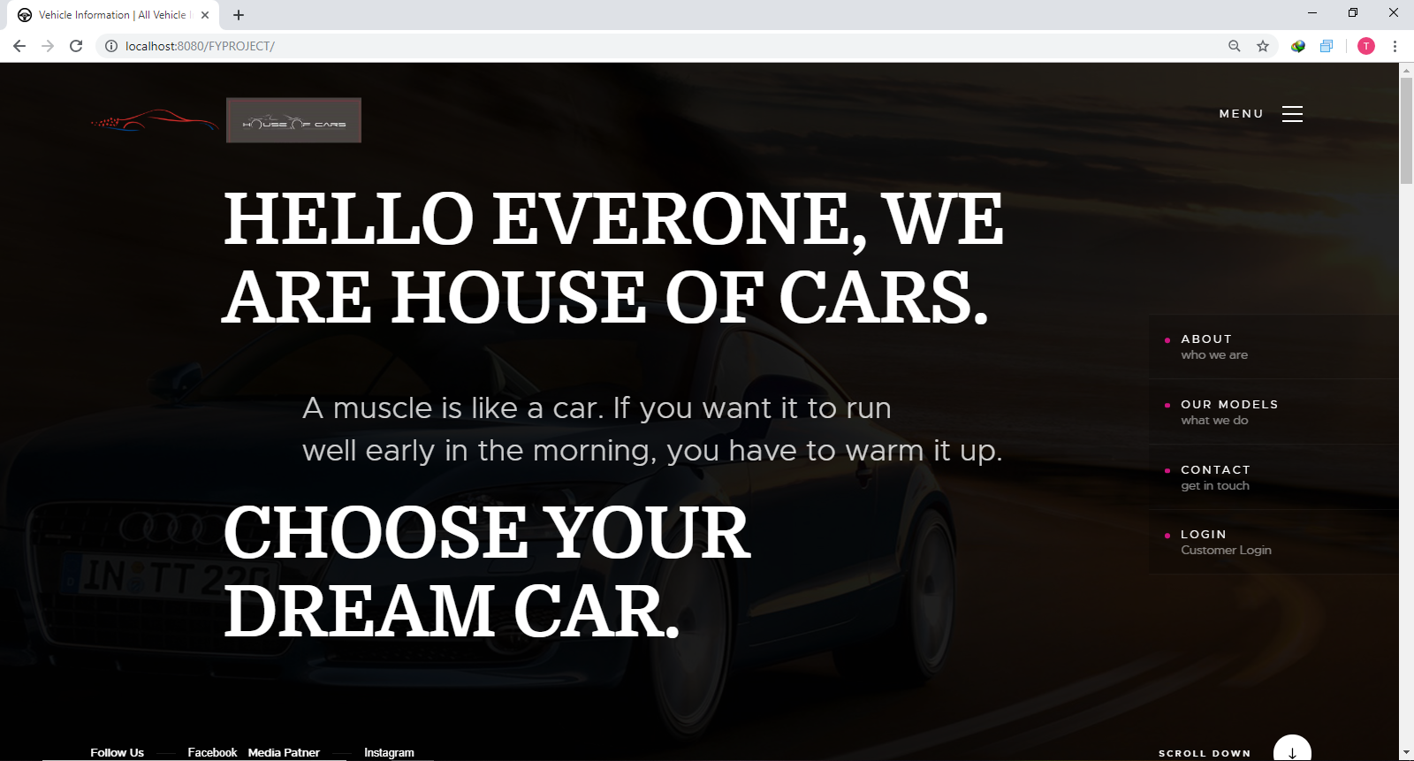

Slide 7
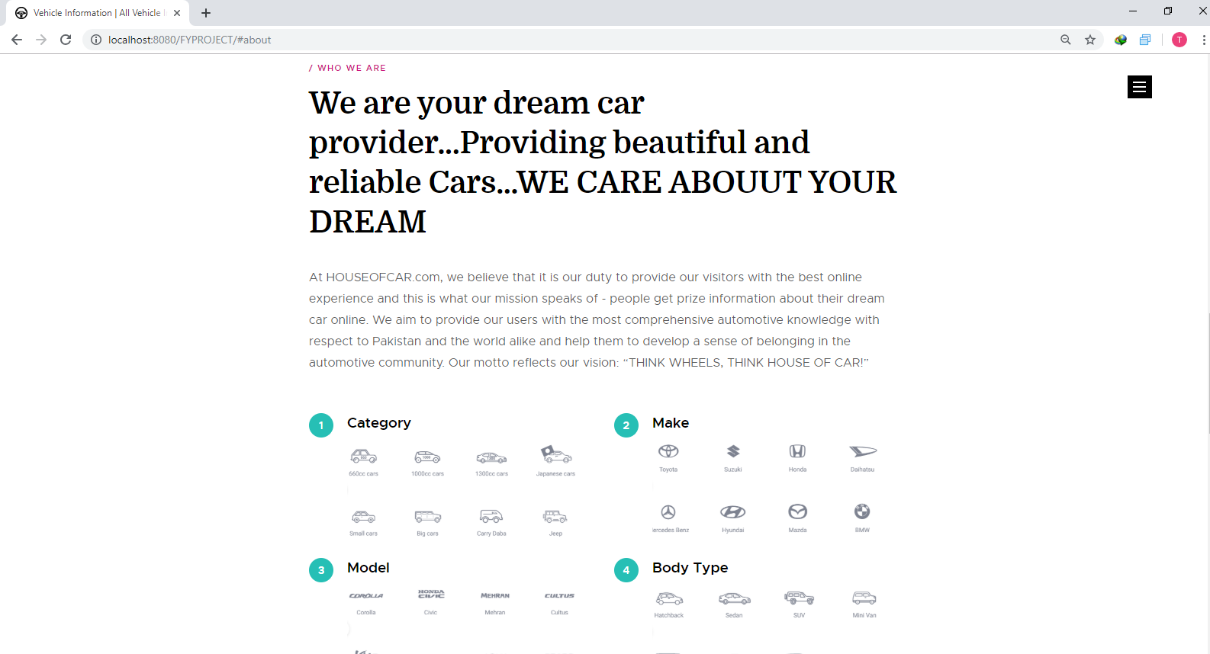
ABOUT

Slide 8
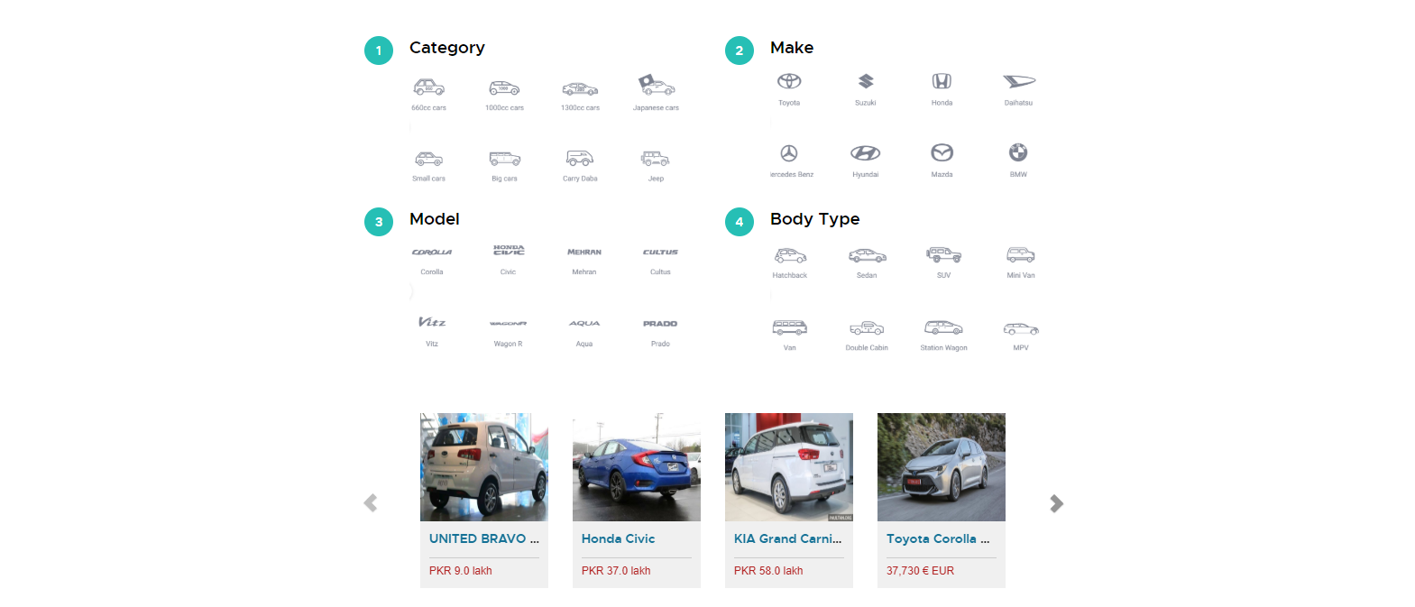

Slide 9
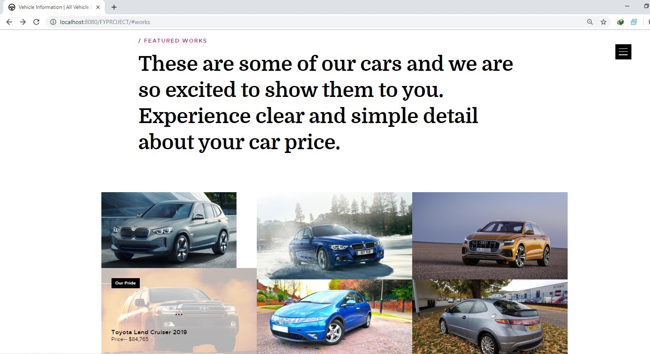
OUR MODELS

Slide 10

CONTACT US

Slide 11

USERS FEEDBACK

Slide 12
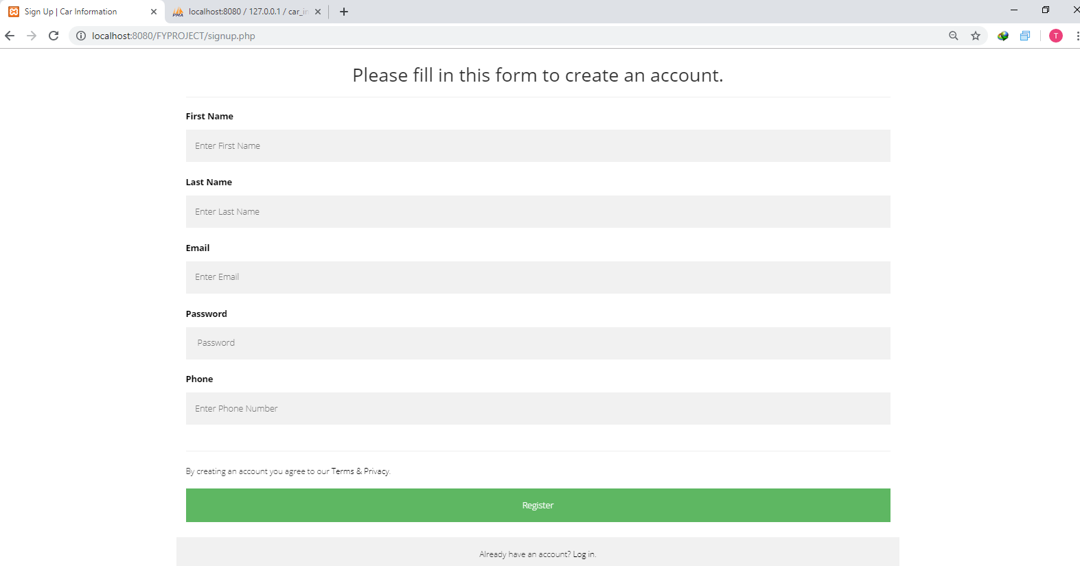
SIGN UP FORM

Slide 13
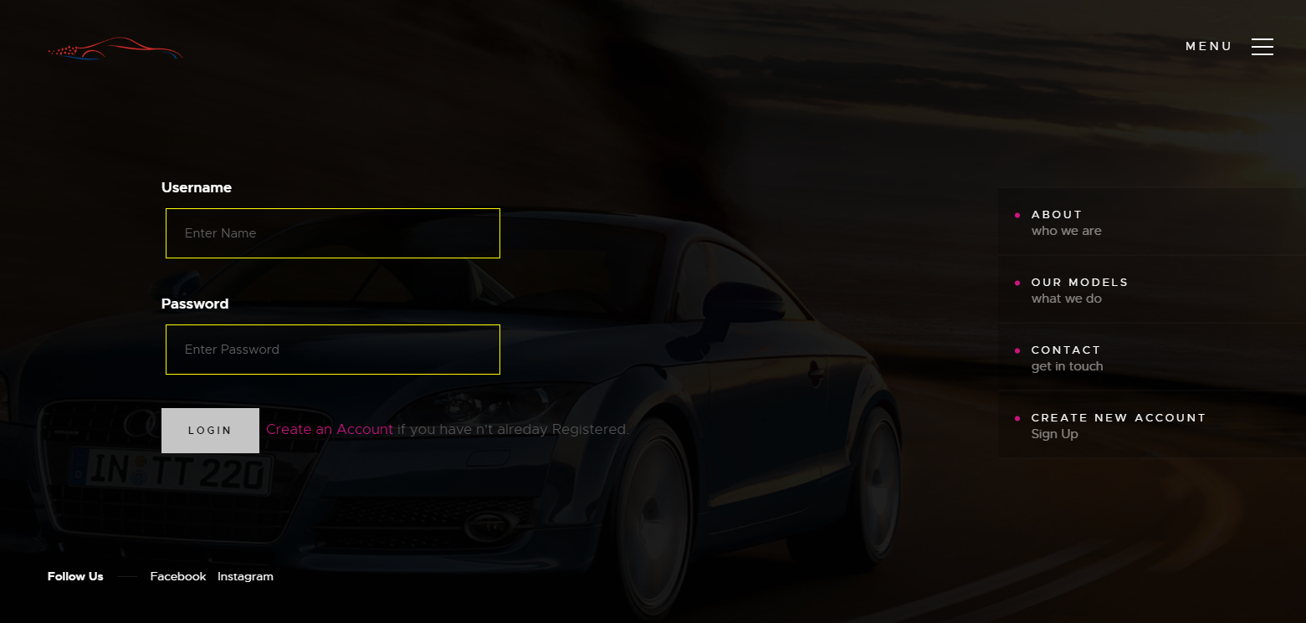
LOGIN FORM

Slide 14
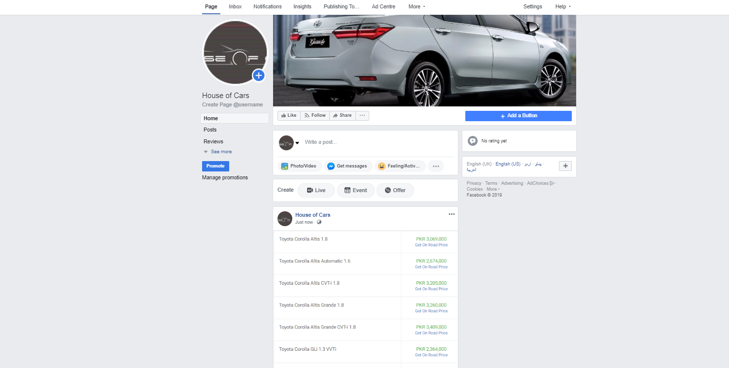
FOLLOW US ON SOCIAL MEDIA

Slide 15
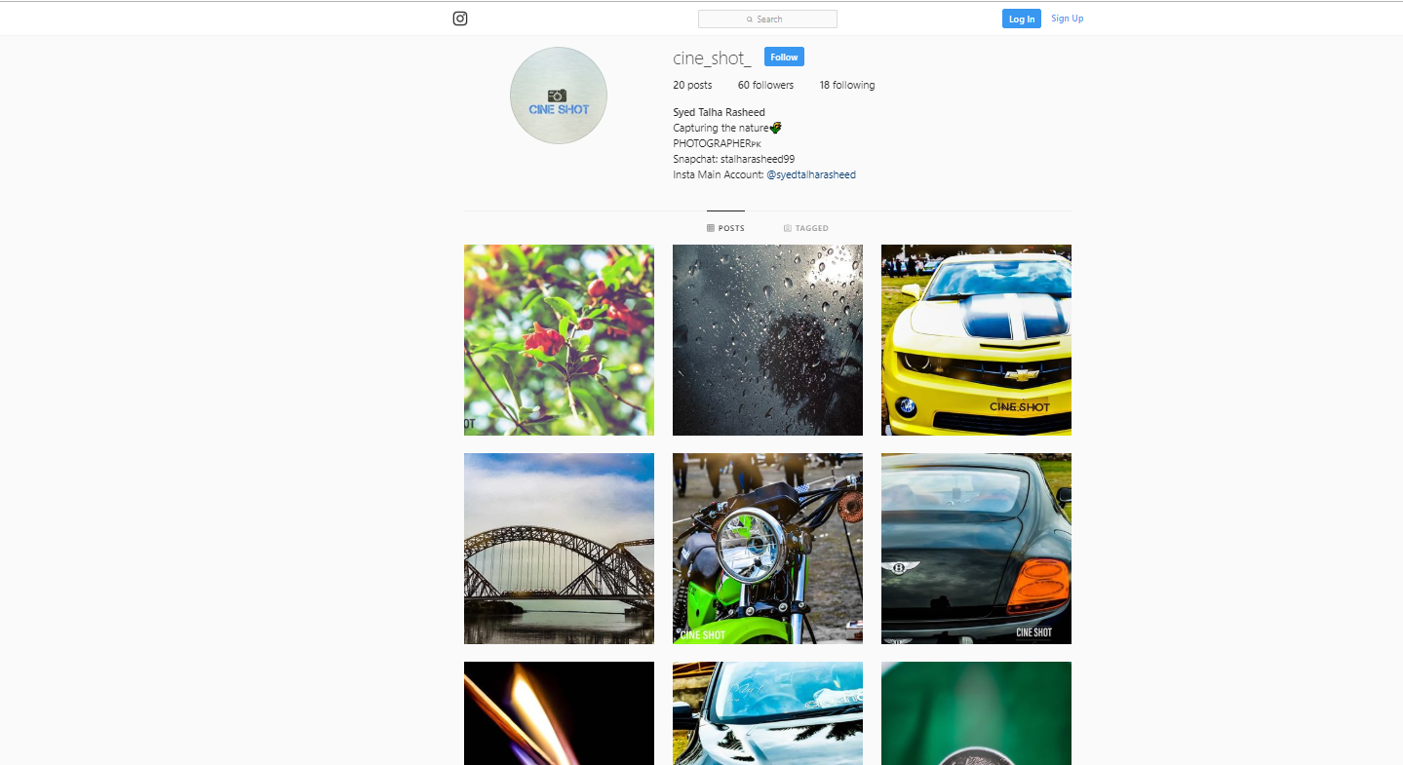
MEDIA PATNER

Slide 16
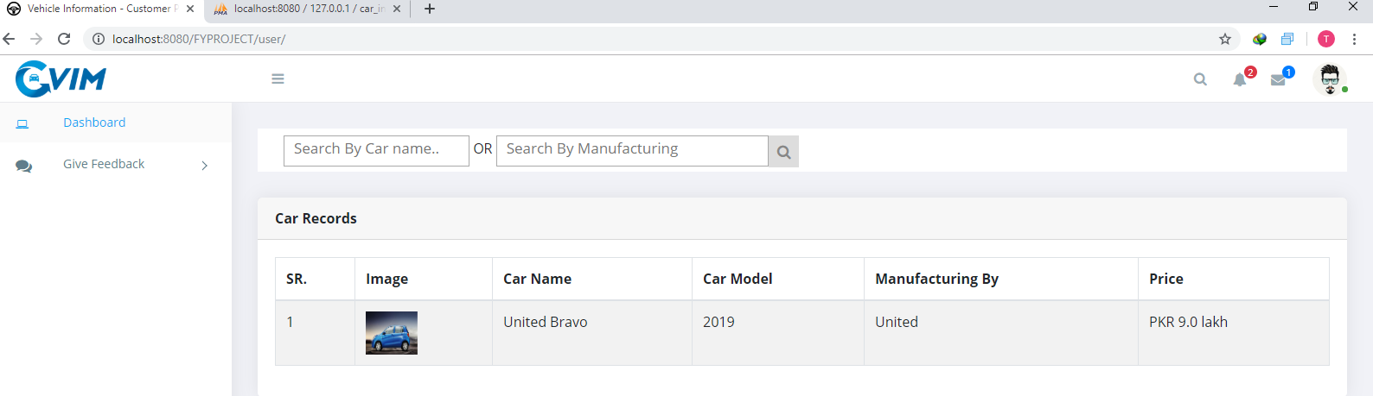
USER

Slide 17
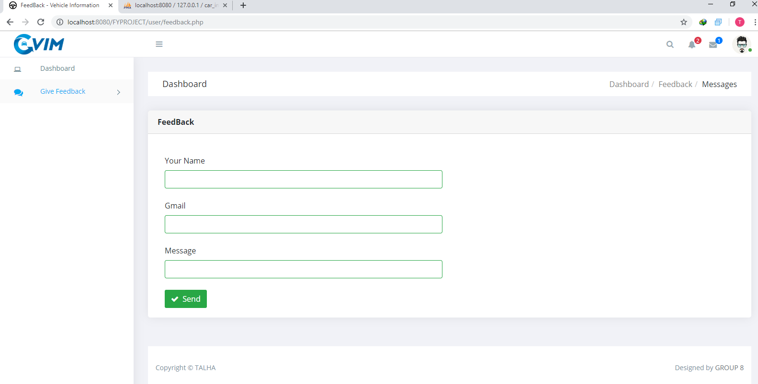
USER FEEDBACK

Slide 18
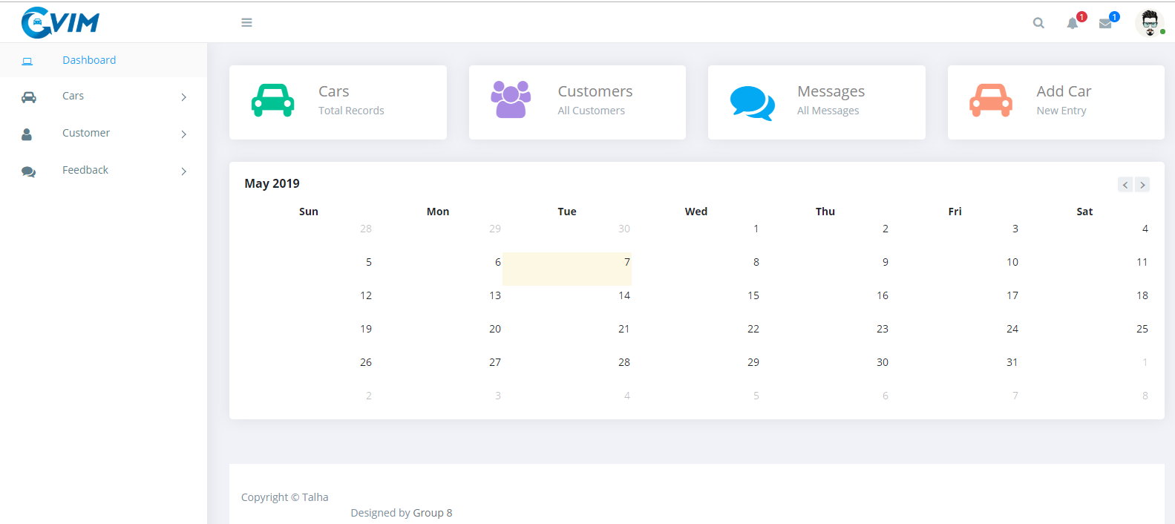
ADMIN

Slide 19
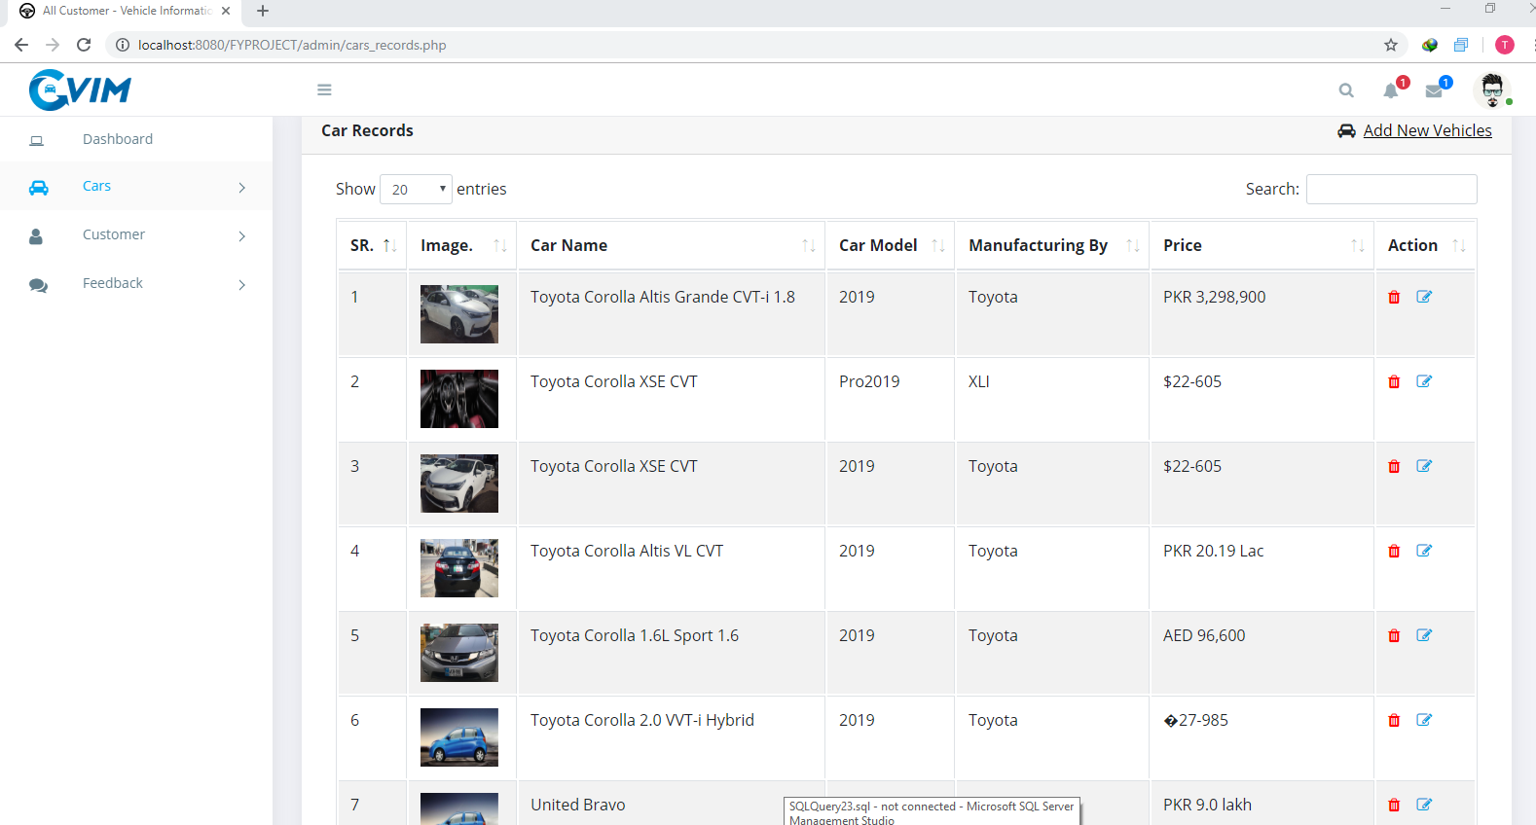
CAR RECORDS

Slide 20
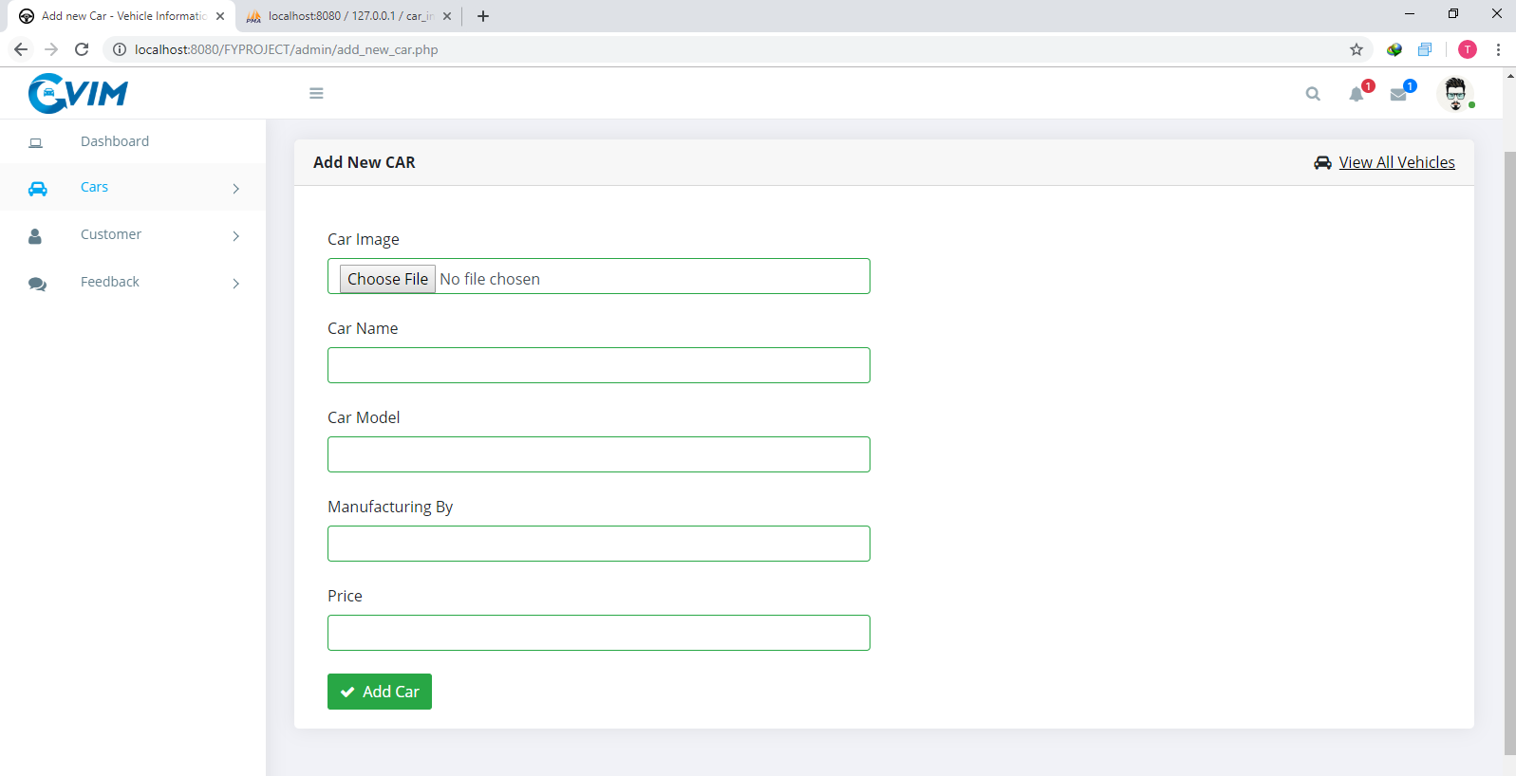
INSERT DATA FOR NEW CARS

Slide 21
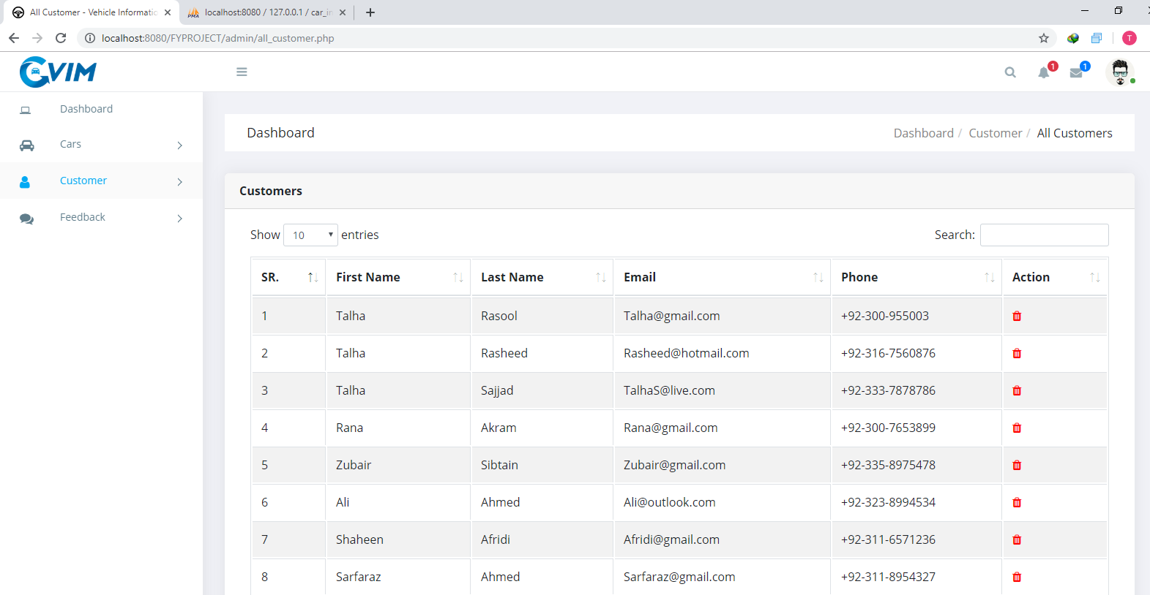
CUSTOMERS DATA

Slide 22
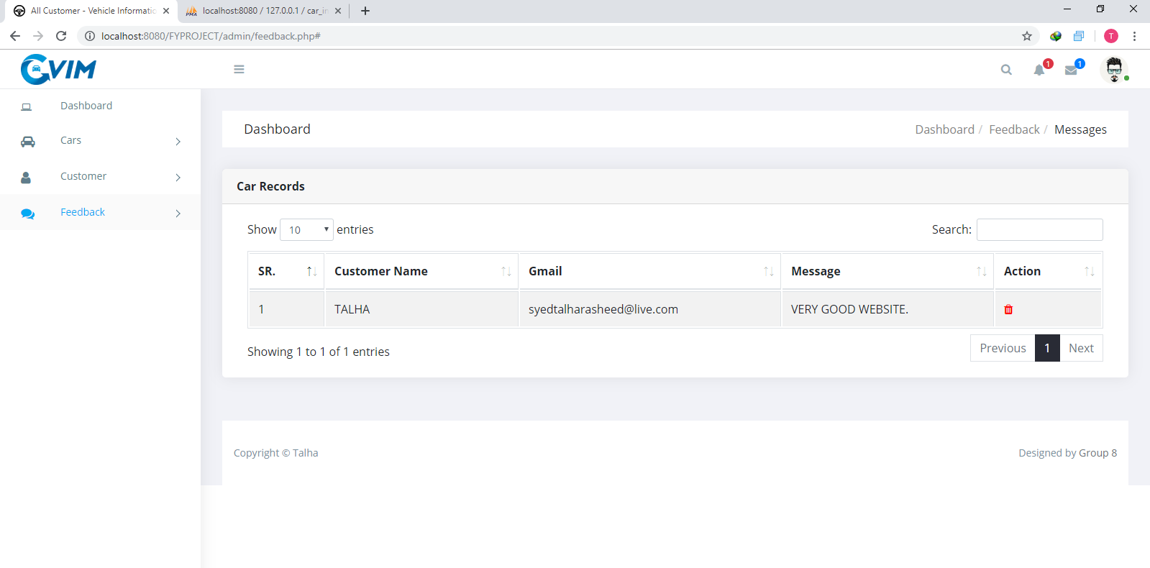
USERS FEEDBACK DATA

Slide 23
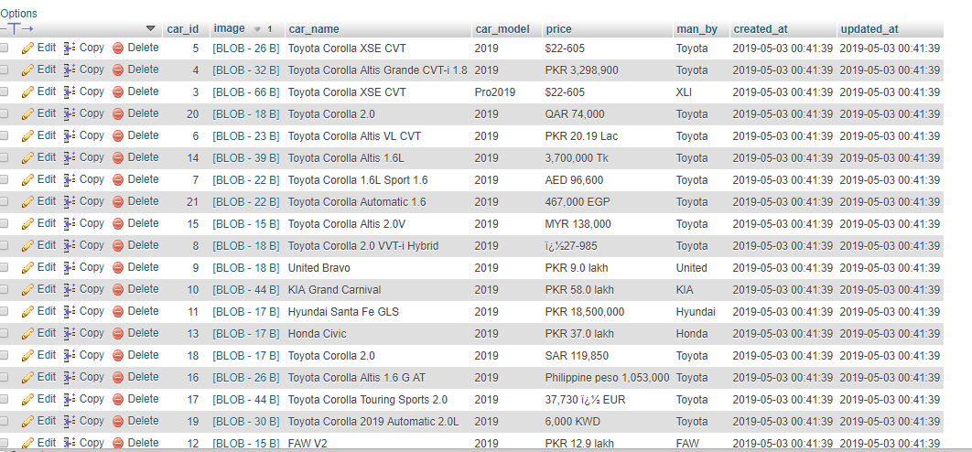
DATABASE OF CARS

Slide 24
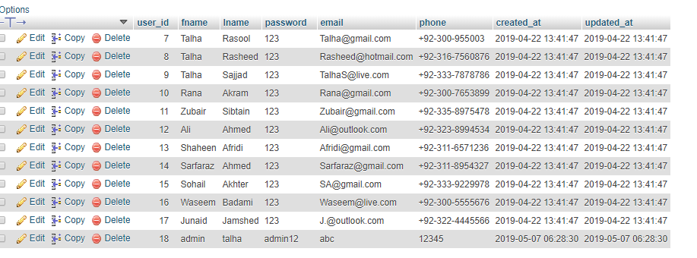
DATABASE OF USERS

Slide 25
DATABASE OF USER FEEDBACK

Slide 26


